Slide 1
REGRESSION ANALYSIS
Linear · Multiple · Polynomial · Ridge · Lasso · Logistic
Topics Covered:
▸ When to trust Beta and when not to
▸ What R² really means for your models
▸ How the Intercept changes your Beta interpretation
▸ Fair value of spread using regression
▸ Assumptions, mistakes, and which model to use when

Slide 2
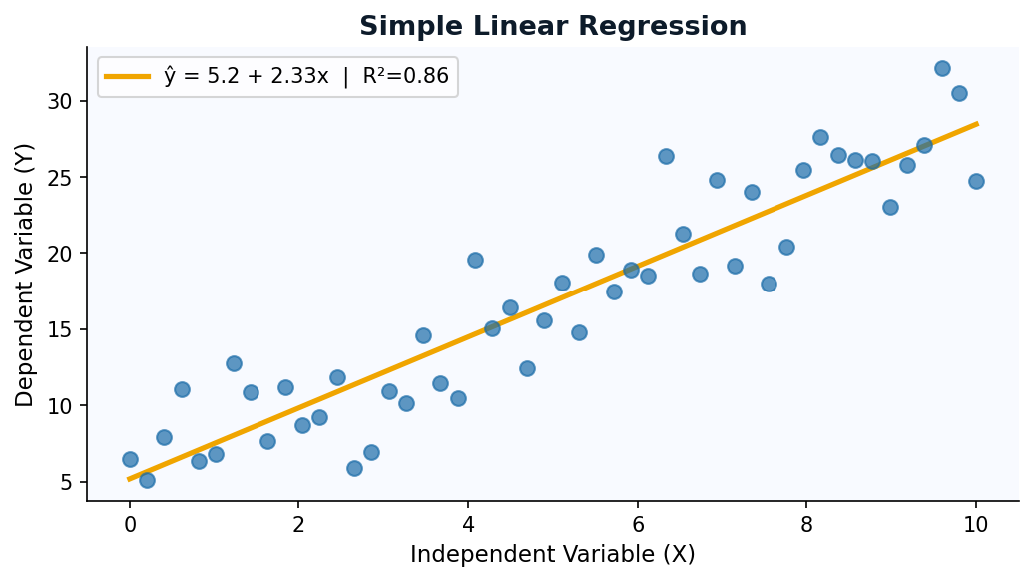
Simple Linear Regression
ŷ = α + βX | One predictor, one outcome
The Equation
ŷ = α + β · X
α (Alpha/Intercept): value of Y when X = 0 β (Beta/Slope): change in Y per unit change in X
Example
Brent Crude = 2.3 + 0.85 × WTI β = 0.85: For every $1 move in WTI, Brent moves $0.85 α = 2.3: Structural Brent premium above WTI
To find the best fit line, we use a method called ,Ordinary Least Squares , minimizes the sum of squared residuals — the vertical distance between each point and the line. It finds the β and α that make prediction errors as small as possible.

Slide 3
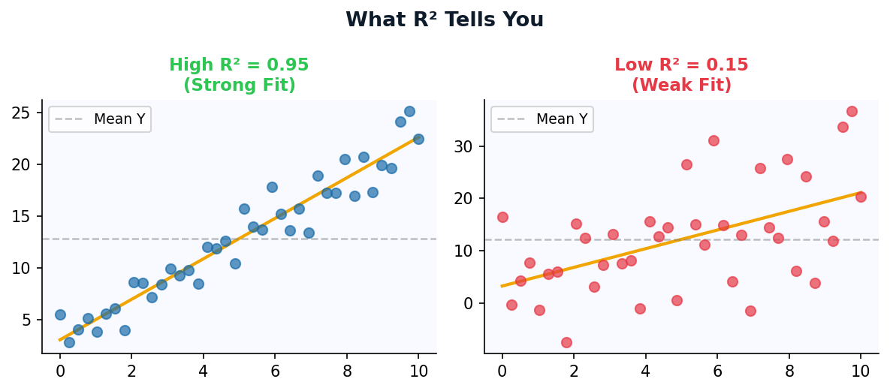
R² — Coefficient of Determination
R² does NOT mean your model is correct. It measures explained variance.
The Formula
R² = 1 − (SS_res / SS_tot)
SS_res = sum of squared residuals
SS_tot = total variance in Y
R² = 0.90+
Strong: 90%+ variance explained. Good for liquid pairs.
R² = 0.60–0.89
Moderate: Meaningful relationship. Use with caution.
⚠️ CRITICAL MISTAKES WITH R²
R² < 0.30
1. High R² ≠ Good model: You can get R²=0.98 by just adding useless variables (that's what Adjusted R² fixes). 2. In-sample vs Out-of-sample: Always test on unseen data. Futures models with in-sample R²=0.99 can be pure noise. 3. R² ignores direction of errors.
Weak: Model explains little. Add factors or reconsider.

Slide 4
When to Trust Beta — and When to Ignore It
A statistically significant Beta ≠ a large Beta. Understand p-values and standard errors.
The Trust Framework
p < 0.01
High Confidence
Trade on it. Beta is statistically very robust.
You should check:
Is it statistically significant? (p-value)
Is it stable? (multicollinearity?)
Is it meaningful in size? (β magnitude)
Does the model explain enough? (R²)
p < 0.05
Standard
Acceptable threshold. Monitor for regime changes.
p < 0.10
Weak Signal
Use only with strong fundamental backing.
p > 0.10
❌ Ignore
Beta is noise. Do NOT use as hedge ratio or signal.
Multicollinearity: When X variables are correlated, individual Betas become unreliable even with high R². The sign can flip!
Non-stationarity: In futures, relationships shift with term structure, carry, and regime. A Beta from 2019 may be of no use in 2024

Slide 5
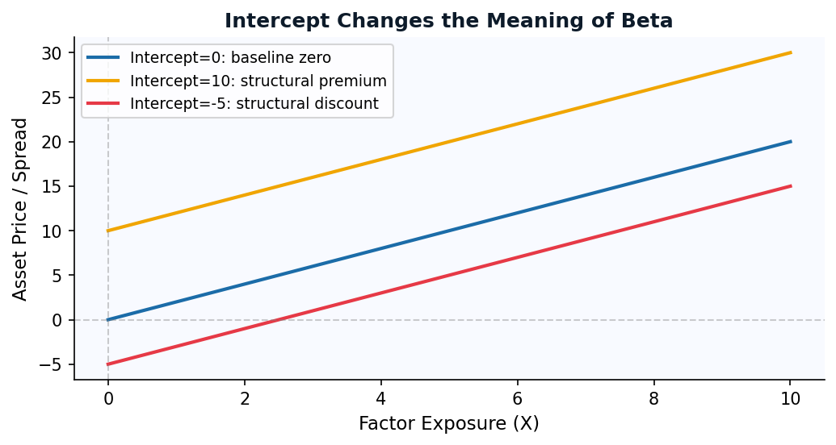
The Intercept
Ignoring the intercept forces your model through zero — and warps your Beta.
What the Intercept IS
The intercept (α) captures the baseline level of Y when ALL predictors = 0. In trading: it is the structural premium or discount that exists independently of the factor.
The Intercept Trap
If you suppress the intercept (force α=0), the model compensates by inflating or deflating β. You'll get a wrong hedge ratio and wrong fair value for your spread.
✅ Practical Rule for Spread Trading
Always include intercept. Example: Brent–WTI spread. If you regress Brent on WTI WITHOUT intercept, β absorbs the quality premium. Your hedge ratio becomes too high. With intercept: α = quality premium (stable), β = co-movement sensitivity (your real hedge ratio). Alpha IS the fair spread. If observed spread >> α, it's rich; if << α, it's cheap.

Slide 6
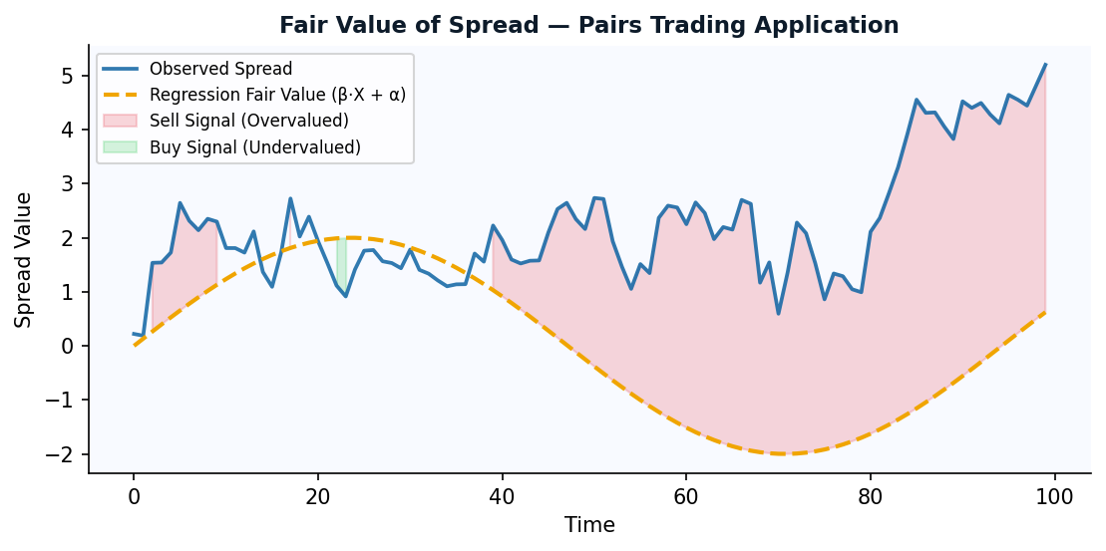
Fair Value of Spread
Regression gives you the theoretical fair value.
The Framework
1
Regress Spread on Factor
Spread = α + β·Factor + ε
2
Compute Fair Value
FV = α̂ + β̂·Factor (in-sample fitted line)
3
Compute Residual
Residual = Spread − Fair Value = ε
4
Trade the Mean Reversion
Long when ε << 0, Short when ε >> 0
β gives the hedge ratio (how much of Asset B to short against Asset A). α gives the fair spread level. The residual (ε) is your signal. Z-score the residuals over a rolling window to normalize entry/exit thresholds. Entry: z > ±2. Exit: z → 0. Stop: z > ±3 (model may have broken).
Key Insight:

Slide 7
OLS Assumptions
Regression is powerful when assumptions hold.
1
Linearity
2
No Autocorrelation
✅ Y truly has a linear relationship with X
✅ Errors shouldn't show repeating patterns, especially in time-based data.
❌ Non-linear relationship → use polynomial
3
Homoscedasticity
4
Normality of Errors
✅ Residual variance is constant across all X values
✅ Residuals are normally distributed
5
No Multicollinearity
6
No Endogeneity
X variables are not highly correlated
X is not correlated with the error term
↔️
Causation is reverse or bidirectional → instrumental variables

Slide 8
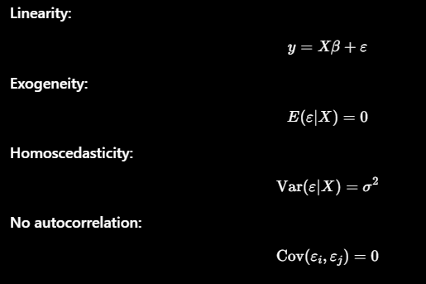
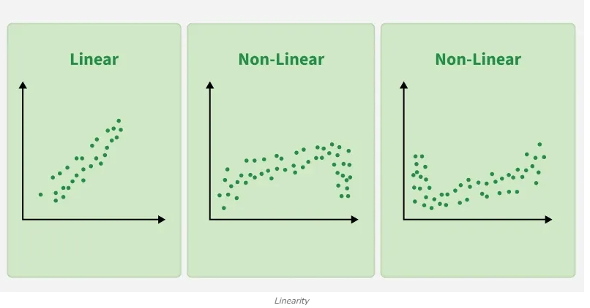
1. Linearity
!

Slide 9
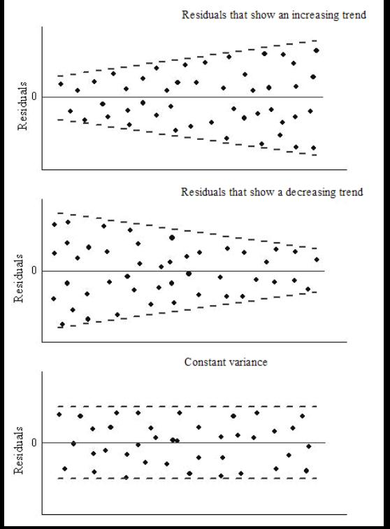
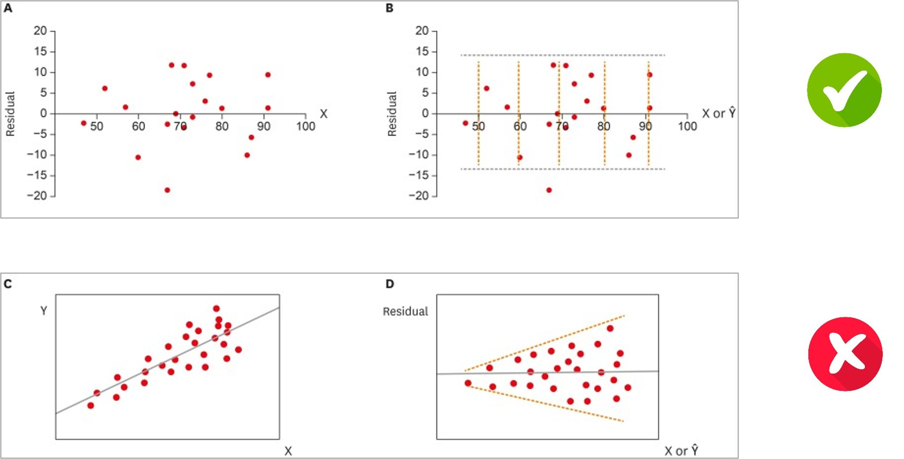
2. Constant Variance (Homoscedasticity):
!

Slide 10
Multiple Linear Regression
ŷ = α + β₁X₁ + β₂X₂ + … + βₙXₙ | More factors, more complexity
The Model
ŷ = α + β₁X₁ + β₂X₂ + … + βₙXₙ
Each β is a PARTIAL coefficient — the effect of Xᵢ on Y, holding all other X variables constant. This is crucial: β₁ in multiple regression is NOT the same as β in simple regression if X₁ is correlated with other Xs.
Adjusted R²
Multicollinearity
Use this instead of R². Adding variables always increases R² but Adj-R² penalizes for each added predictor.
Compute VIF (Variance Inflation Factor). VIF > 10 = danger. Correlated factors make individual Betas meaningless.

Slide 11
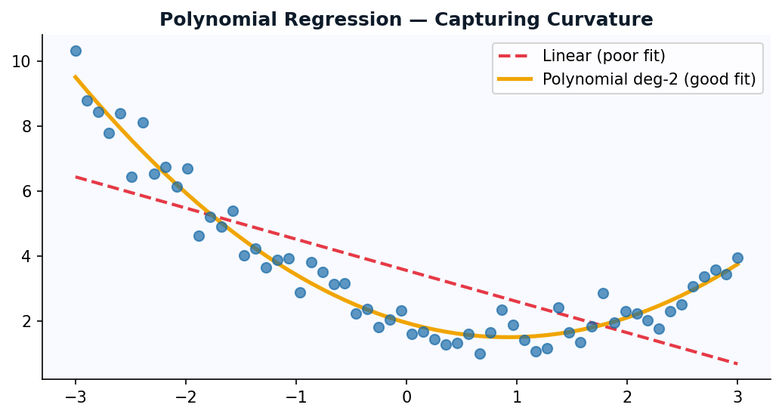
Polynomial Regression
ŷ = α + β₁X + β₂X² + β₃X³ | Non-linear relationships, linear estimation
Why Use It?
Many relationships in derivatives and commodities are non-linear:
• Carry vs term structure
• Option delta vs money
• Price impact (concave curve)
Degree Selection
Degree 1: Linear baseline Degree 2: Quadratic, U-shape, vol surface Degree 3: Cubic, S-curves, yield shapes Degree 5+: Likely overfitting!
Polynomial regression is still LINEAR in parameters (it uses X, X², X³ as separate features). The danger is overfitting — high degree polynomials wiggle through training data but blow up on new data. Always use cross-validation to pick degree. For derivatives vol surfaces, prefer cubic splines.

Slide 12
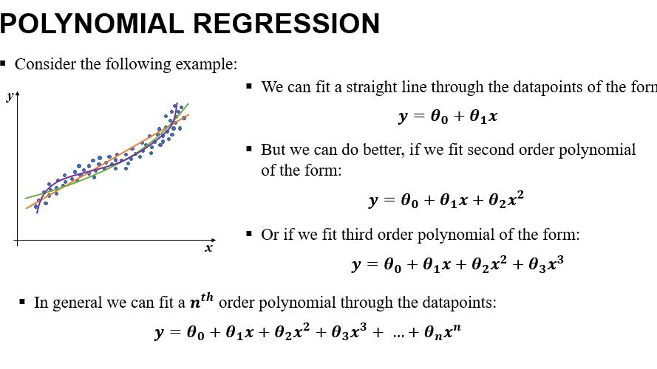

Slide 13
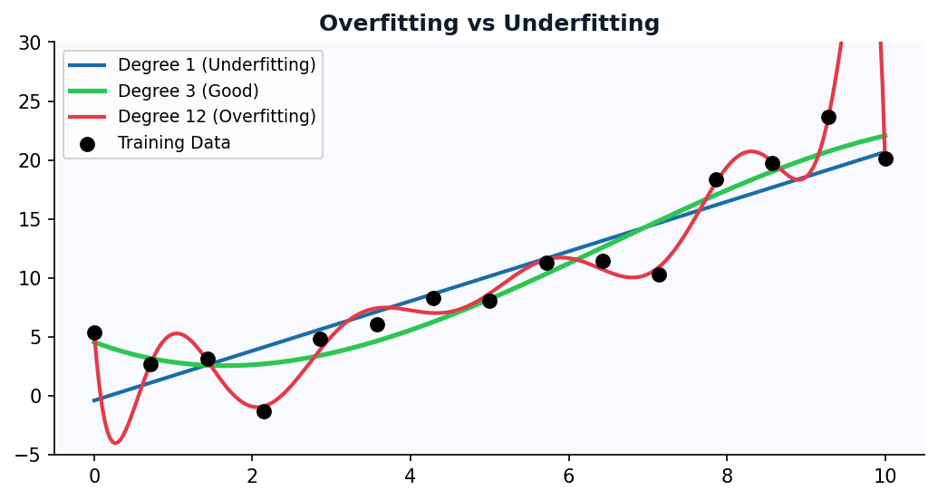
Overfitting: memorizing training data instead of learning pattern
!
The Validation Framework
Train (60%): Fit model → Validate (20%): Tune hyperparameters (λ for Ridge/Lasso, degree for Poly) → Test (20%). Final performance. If bad here, throw the model away. Never retune after seeing test performance.

Slide 14
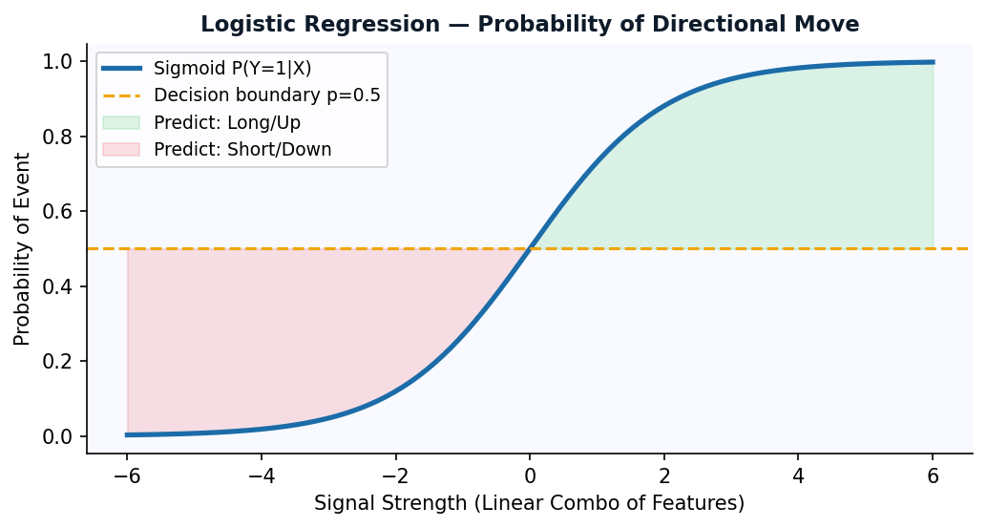
Logistic Regression — Predicting Direction
Unlike linear regression, which predicts continuous values it predicts the probability that an input belongs to a specific class. For probability of UP vs DOWN, LONG vs SHORT, or EVENT vs NO EVENT.
Key Concepts
Sigmoid Output
P(Y=1) = 1/(1+e^−z). Always between 0 and 1. Interpret as probability.
Log-Odds (Logit)
log(p/1−p) = α + β₁X₁ + … Linear in log-odds, non-linear in probability.
Coefficient Interpretation
e^β = odds ratio. β=0.5 → factor multiplies odds of UP by e^0.5=1.65x.
Threshold
Default p>0.5 → Long. Adjust threshold based on cost of false signals.
Trading Applications of Logistic Regression
Direction signal: P(next-day return > 0 | carry, momentum, basis signals)
• Regime: P(contango vs backwardation regime) to switch carry strategy on/off.

Slide 15
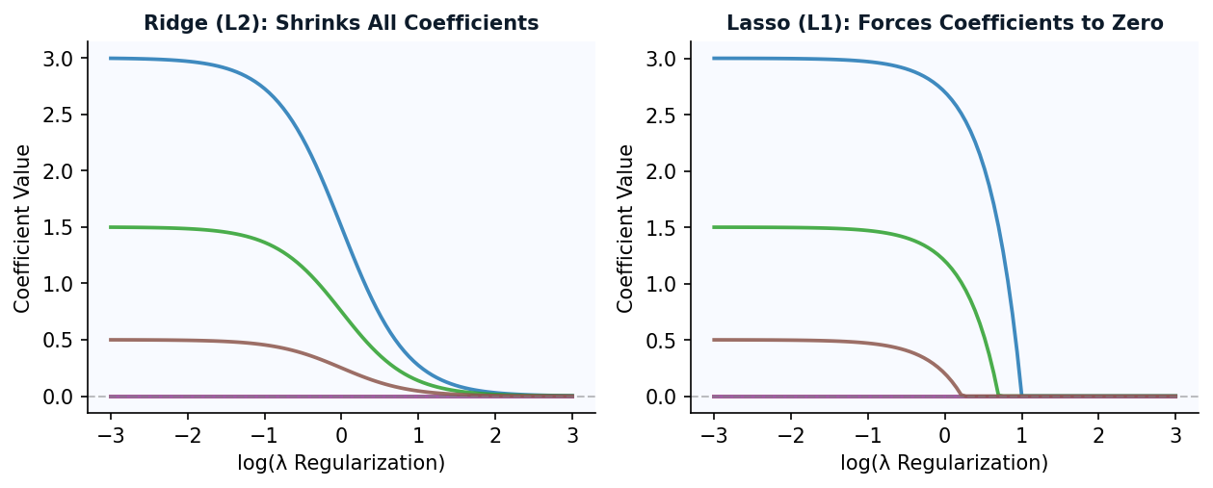
Ridge Regression (L2 Regularization)
Minimize: Σ(y − ŷ)² + λΣβᵢ² | Shrinks all coefficients toward zero, but never to exactly zero
What it solves
The λ (lambda)
In Practice
Limitation
Multicollinearity. When factors are correlated, OLS Betas are huge and unstable. Ridge shrinks them all proportionally, stabilizing estimates.
λ=0 is pure OLS. As λ→∞, all Betas→0. Cross-validate to find optimal λ on out-of-sample data.
Use when you have many factors (macro indicators, technical signals) that overlap. All variables stay in the model. Good when you believe all features contribute.
Ridge never zeroes out a coefficient — no automatic variable selection. If you want sparsity, use Lasso. No interpretable feature elimination.

Slide 16
Lasso Regression (L1 Regularization)
Minimize: Σ(y − ŷ)² + λΣ|βᵢ| | Forces some coefficients to exactly zero — automatic variable selection
Why Lasso is Special for Trading
Ridge vs Lasso Decision Guide
Sparse Signals
 | Ridge | Lasso
Variable selection | ❌ No | ✅ Yes
Correlated factors | ✅ Better | ❌ Picks one
Sparse true model | ❌ Worse | ✅ Better
Interpretability | Moderate | ✅ High
Out of 50 macro variables, maybe 5 actually predict futures returns. Lasso finds them and zeroes the rest out — Ridge cannot do this.
Factor Selection
Run Lasso on your signal universe (momentum, carry, value, basis, skew...). Surviving factors with non-zero Beta are your active predictors.
Interpretability
Elastic Net — Best of Both
You end up with a lean model: e.g. β_carry=0.31, β_momentum=0.19, everything else=0. Easy to explain to PM or risk committee.
Penalty = λ₁Σ|βᵢ| + λ₂Σβᵢ²
Combines L1 and L2. Handles correlated groups of features better than Lasso alone (Lasso arbitrarily picks one from a correlated group). The go-to for large macro factor models.
Regime-Robust
Fewer parameters = less overfitting. Lasso models tend to generalize better across market regimes than kitchen-sink OLS.
Use Lasso when you believe only a few factors matter. Ridge when most factors contribute but are correlated. Elastic Net when both might be true.

Slide 17
Which Regression Model to Use
Situation / Use Case | Recommended Model | Why?
1 factor, stable relationship (Brent vs WTI) | Simple Linear | Clean, interpretable, easy to monitor
Multiple macro factors, all likely relevant | Multiple OLS + Ridge | Ridge handles correlated macro vars
Large signal universe (50+ features) | Lasso or Elastic Net | Auto-selects relevant signals
Non-linear relationship (vol smile, carry curve) | Polynomial or Spline | Captures curvature in data
Predict direction (Long/Short signal) | Logistic Regression | Output is probability [0,1]
Many correlated factors, sparse true model | Elastic Net | Combines L1 sparsity + L2 stability
Price-based regression (non-stationary) | Cointegration | Avoid spurious regression — CRITICAL

